Slide 1
Amazon Compute
By Tamal Dey
CA,PESU

Slide 2
What is EC2?
Elastic Compute Cloud – EC2
It is web service that provide secure , resizable compute capacity in the cloud
It is designed to make web-scale cloud computing easier for developers
EC2 is a simple web service interface makes it easier to provision and configure capacity by using APIs
You will have the complete control on the computing resources and they will be running on amazons infrastructure.
Notes:
the action of providing or supplying something for use.
"new contracts for the provision of services"

Slide 3
EC2 reduces the time required to obtain and boot new server instances in minutes.
You can scale up and down capacity as your requirements change
Pay-as-you-go
It provides the users to build the failure-resilient applications and isolate them from common failure scenarios :
"Beginner mistakes" on the part of service providers.
Security flaws that hackers eventually expose.
Poor processes within the cloud.
Notes:
Instances: an example or single occurrence of something.

Slide 4
EC2 instance
Several properties has to be configured in the EC2 instance
AMI – Amazon Machine Image
The instance type/hardware profile – General purpose, compute optimised, memory optimized, accelerated compute, storage optimized
Security groups
Storage
Key pairs
Notes:
An Amazon Machine Image (AMI) is a special type of virtual appliance that is used to create a virtual machine within the Amazon Elastic Compute Cloud ("EC2").

Slide 5
Quiz
The application will run on Linux. What service will you use to create your first server instance in AWS to run Linux?
Amazon S3
Amazon Cognito
Amazon EC2
ANS: Amazon EC2

Slide 6
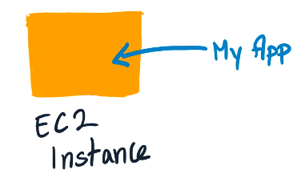
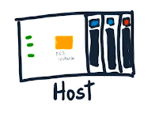
So where is my code really running?
EC2 instance is a VM that gives us resources such as VCPU and RAM
This VM runs on a physical server within the AWS facility
In AWS, we call this as the host machine
A hypervisor mediates access between your code and the underlying server and provides isolation from other workloads that may be running on that machine

Slide 7
Region is a specific geographic area
Region Identifiers ends in numbers
Each region has multiple, isolated locations known as Availability Zones (AZ)
AZ identifiers ends in alphabets
The host is physically located in an Availability Zone (AZ)
Some services are region specific and some are AZ specific
EC2 is AZ specific i.e, Resources aren't replicated across regions unless you do so specifically.

Slide 8
Amazon Elastic Compute Cloud (EC2)
Amazon Machine Images (AMIs) are the basic building blocks of Amazon EC2
An AMI is a template that contains a software configuration (operating system, application server and applications) that can run on Amazon’s computing environment
AMIs can be used to launch an instance, which is a copy of the AMI running as a virtual server in the cloud.

Slide 9
Getting Started with Amazon EC2
Step 1: Sign up for Amazon EC2
Step 2: Create a key pair
Step 3: Launch an Amazon EC2 instance
Step 4: Connect to the instance
Step 5: Customize the instance
Step 6: Terminate instance and delete the volume created

Slide 10
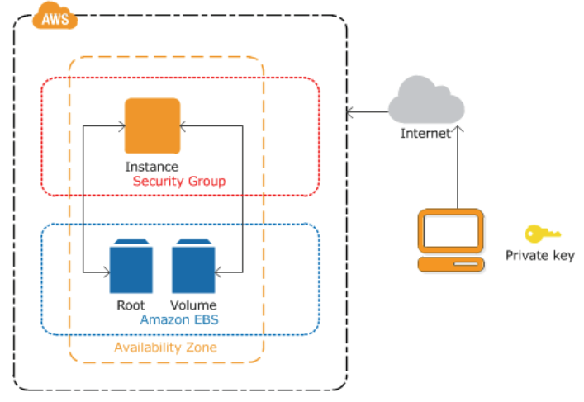

Slide 11
Creating a key pair
AWS uses public-key cryptography to encrypt and decrypt login information.
AWS only stores the public key, and the user stores the private key.
There are two options for creating a key pair:
Have Amazon EC2 generate it for you
Generate it yourself using a third-party tool such as OpenSSH, then import the public key to Amazon EC2

Slide 12
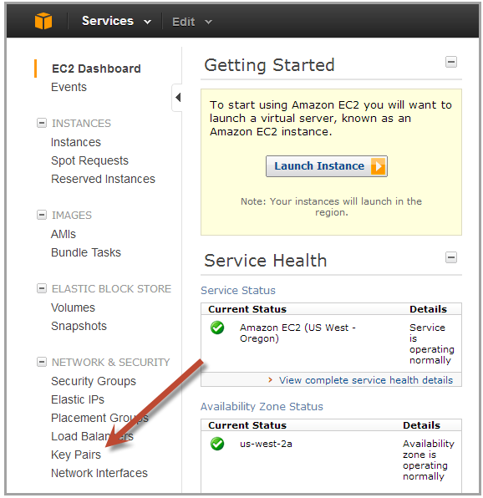
Generating a key pair with Amazon EC2
Open the Amazon EC2 console at http://console.aws.amazon.com/ec2/
On the navigation bar select region for the key pair
Click Key Pairs in the navigation pane to display the list of key pairs associated with the account

Slide 13
Generating a key pair with EC2 (cont.)
Click Create Key Pair
Enter a name for the key pair in the Key Pair Name field of the dialog box and click Create
The private key file, with .pem extension, will automatically be downloaded by the browser.

Slide 14
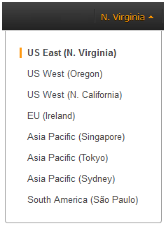
Launching an Amazon EC2 instance
Sign in to AWS Management Console and open the Amazon EC2 console at http://console.aws.amazon.com/ec2/
From the navigation bar select the region for the instance

Slide 15
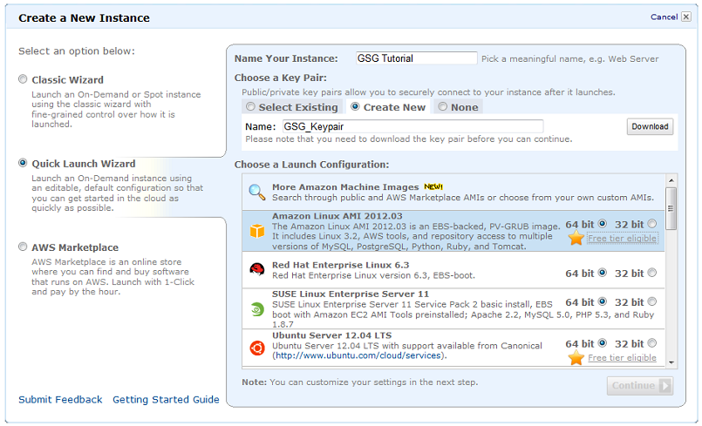
From the Amazon EC2 console dashboard, click Launch Instance

Slide 16
On the Create a New Instance page, click Quick Launch Wizard
In Name Your Instance, enter a name for the instance
In Choose a Key Pair, choose an existing key pair, or create a new one
In Choose a Launch Configuration, a list of basic machine configurations are displayed, from which an instance can be launched
Click continue to view and customize the settings for the instance

Slide 17
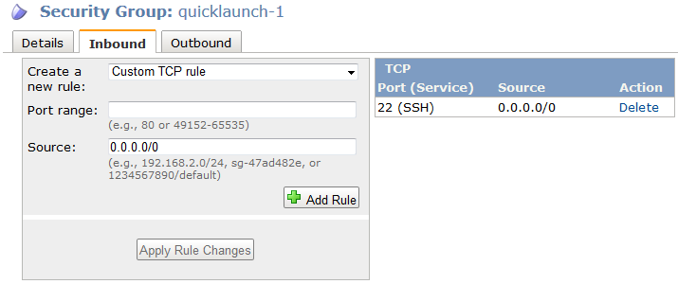
Select a security group for the instance. A Security Group defines the firewall rules specifying the incoming network traffic delivered to the instance. Security groups can be defined on the Amazon EC2 console, in Security Groups under Network and Security

Slide 18
Review settings and click Launch to launch the instance
Close the confirmation page to return to EC2 console
Click Instances in the navigation pane to view the status of the instance. The status is pending while the instance is launching
After the instance is launched, its status changes to running

Slide 19
Connecting to an Amazon EC2 instance
There are several ways to connect to an EC2 instance once it’s launched.
Remote Desktop Connection is the standard way to connect to Windows instances.
An SSH client (standalone or web-based) is used to connect to Linux instances.

Slide 20
Connecting to Linux/UNIX Instances from Linux/UNIX with SSH
Prerequisites:
Most Linux/UNIX computers include an SSH client by default, if not it can be downloaded from openssh.org
Enable SSH traffic on the instance (using security groups)
Get the path the private key used when launching the instance
In a command line shell, change directory to the path of the private key file
Use the chmod command to make sure the private key file isn’t publicly viewable

Slide 21
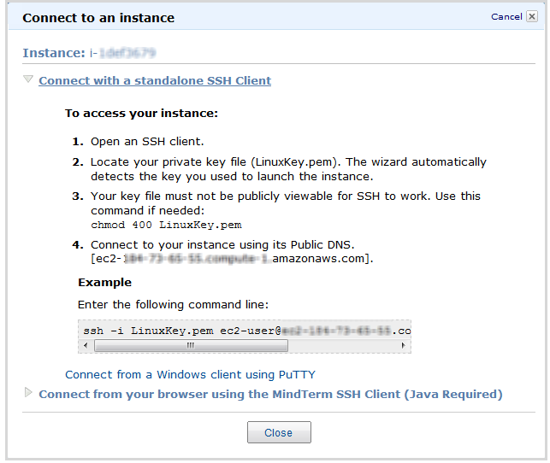
Right click on the instance to connect to on the AWS console, and click Connect.
Click Connect using a standalone SSH client.
Enter the example command provided in the Amazon EC2 console at the command line shell

Slide 22
Transferring files to Linux/UNIX instances from Linux/UNIX with SCP
Prerequisites:
Enable SSH traffic on the instance
Install an SCP client (included by default mostly)
Get the ID of the Amazon EC2 instance, public DNS of the instance, and the path to the private key
If the key file is My_Keypair.pem, the file to transfer is samplefile.txt, and the instance’s DNS name is ec2-184-72-204-112.compute-1.amazonaws.com, the command below copies the file to the ec2-user home

Slide 23
Terminating Instances
If the instance launched is not in the free usage tier, as soon as the instance starts to boot, the user is billed for each hour the instance keeps running.
A terminated instance cannot be restarted.
To terminate an instance:
Open the Amazon EC2 console
In the navigation pane, click Instances
Right-click the instance, then click Terminate
Click Yes, Terminate when prompted for confirmation

Slide 24
Creating a Windows instance
Sign in to the AWS Management Console and open the Amazon EC2 console athttps://console.aws.amazon.com/ec2/.
In the navigation pane, under Instances, choose Instances.
Browse to and choose your Windows Server instance in the list.
Choose Connect.
Choose Get Password.
Choose Browse. Browse to and choose the Amazon EC2 instance key pair file associated with the Windows Server Amazon EC2 instance, and then choose Open.
Choose Decrypt Password. Make a note of the password that is displayed. You need it in step 10.
Choose Download Remote Desktop File, and then open the file.

Slide 25
If you are prompted to connect even though the publisher of the remote connection can't be identified, proceed.
Type the password you noted in step 7, and then proceed. (If your RDP connection client application prompts you for a user name, type Administrator.)
If you are prompted to connect even though the identity of the remote computer cannot be verified, proceed.
After you are connected, the desktop of the Amazon EC2 instance running Windows Server is displayed.
You can now sign out of the running Amazon EC2 instance.

Slide 26
Converting the Ubuntu instance into web server
Connect to the ubuntu instance
sudo apt-get install apache2
Copy the public DNS and paste it in the new browser window
You will get the apache homepage. Now the ec2 instance acts as a web server.

Slide 27
Reading resources
https://www.youtube.com/watch?v=lZMkgOMYYIg

